Slide 1
SCHOOL MANAGEMENT SYSTEM

Slide 2
LORD OF THE CODES
Team Members:
Aduri Ajay
Binsu Susan Thomas
Parvathy Balachandran
Sam Issac
Santhosh Hazare
Vignesh Karthigeyan

Slide 3
SCHOOL MANAGEMENT SYSTEM
It contains
Home page
Academic Information page
About us page
Contact us page
Event page

Slide 4
SCHOOL MANAGEMENT SYSTEM
Academic page contains
Admission Form Link
Staff information Link
Student information Link

Slide 5
SCHOOL MANAGEMENT SYSTEM
Admission information form contains below fields
Student name
Father name
Mother name
Age
Contact details
Addresss
Class info

Slide 6
SCHOOL MANAGEMENT SYSTEM
Staff Information
Faculty name
Subject
classes to teach
contact details

Slide 7
SCHOOL MANAGEMENT SYSTEM
Student Information
Student Name
Father Name
Mother Name
Class
Emergency contact number
Date of birth
Year of Admission
Address

Slide 8
Entities- Tables
Student
Faculty
Admission
Class
Fee
Parent

Slide 9
Student Table
Id
Name
Class
Section
Gender
Blood group
DOB
Admission number
Address
Guardian name
Contact number

Slide 10
Fee Table
ID
Class
Fee

Slide 11
Admission Table
Id
Fee Id
Student Name
Guardian name
Admission date
DOB
Type
Previous School
Blood group
Identity- Proof number
Contact Number
Gender

Slide 12
Class Table
Id
Class Name

Slide 13
Faculty Table
Id
Name
Subject
Address
Qualification
Contact Number

Slide 14
UI
Home Page
Academic information
Admission form link
Faculty Information
Student info
Fee structure
Contact page
Contact Number
Email
Help and Support Form

Slide 15
UI Cont..
Event Page
School Anniversary
Sports events
Food fest
Art fest
Exhibition and Workshops

Slide 16
UI Cont..
About us Page
Details of Institution
Hostel Details
Management Details
Transportation Details

Slide 17
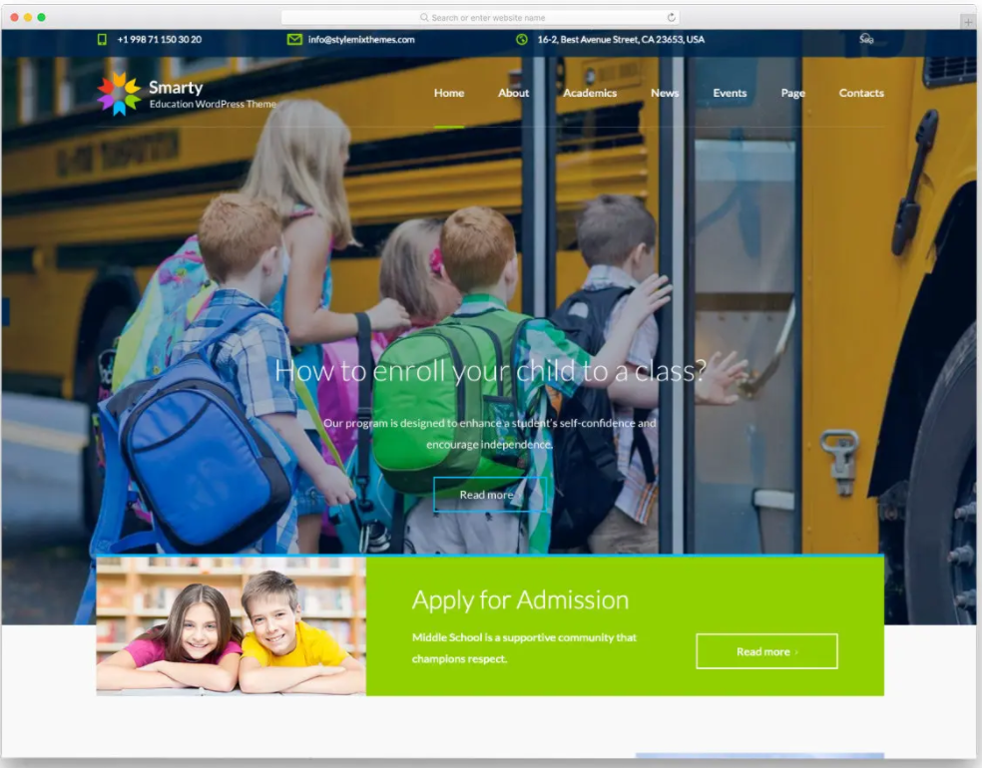
Home Page demo
Demo of Home page
Navigation to other pages are provided,
Also a included tab to apply for the admission

Slide 18
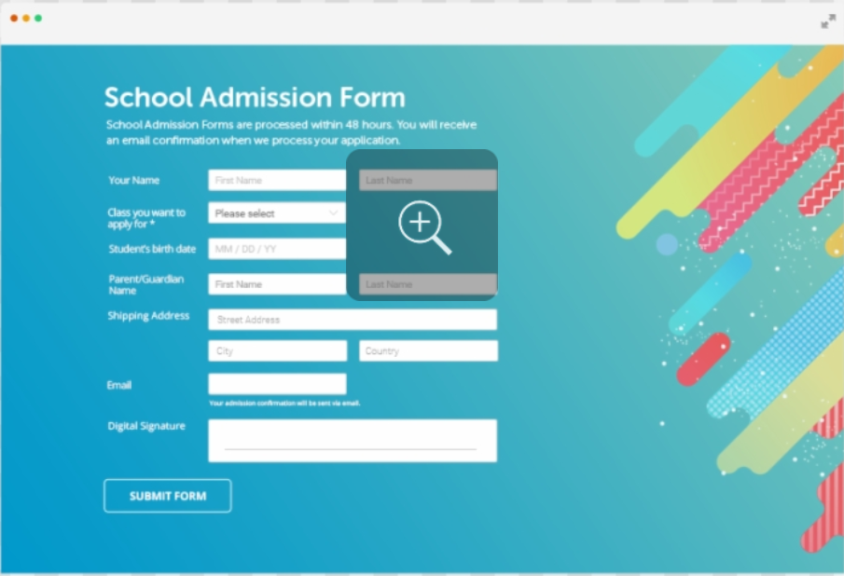
Admission Form demo
Form and it’s labels
Provided with input type text boxes

Slide 19
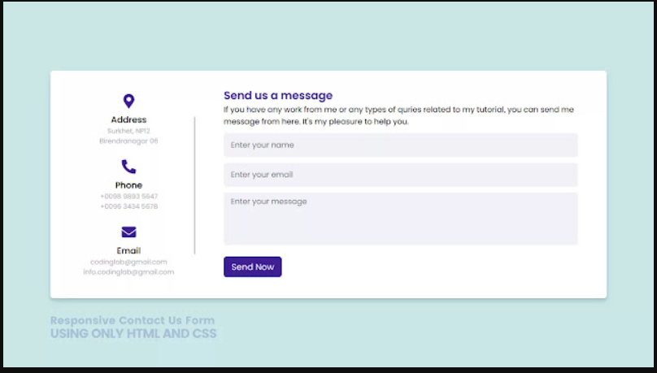
Contact Us pic
Contact us form provided with input text fields to fill up,
And, the contact info

Slide 20
Tools Used:
Reactjs (Front end)
Nodejs (Back end)
Expressjs (Back end)
Mongodb (Data base[DB])
Cascading Style Sheets –CSS (Front end)

Slide 21
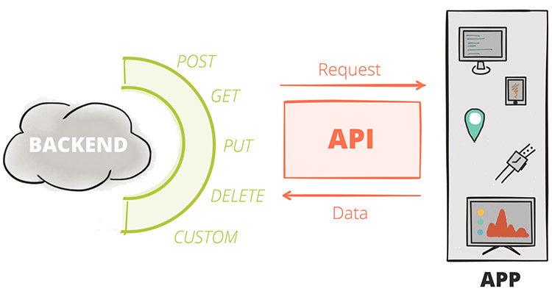
Working Of the App

Slide 22
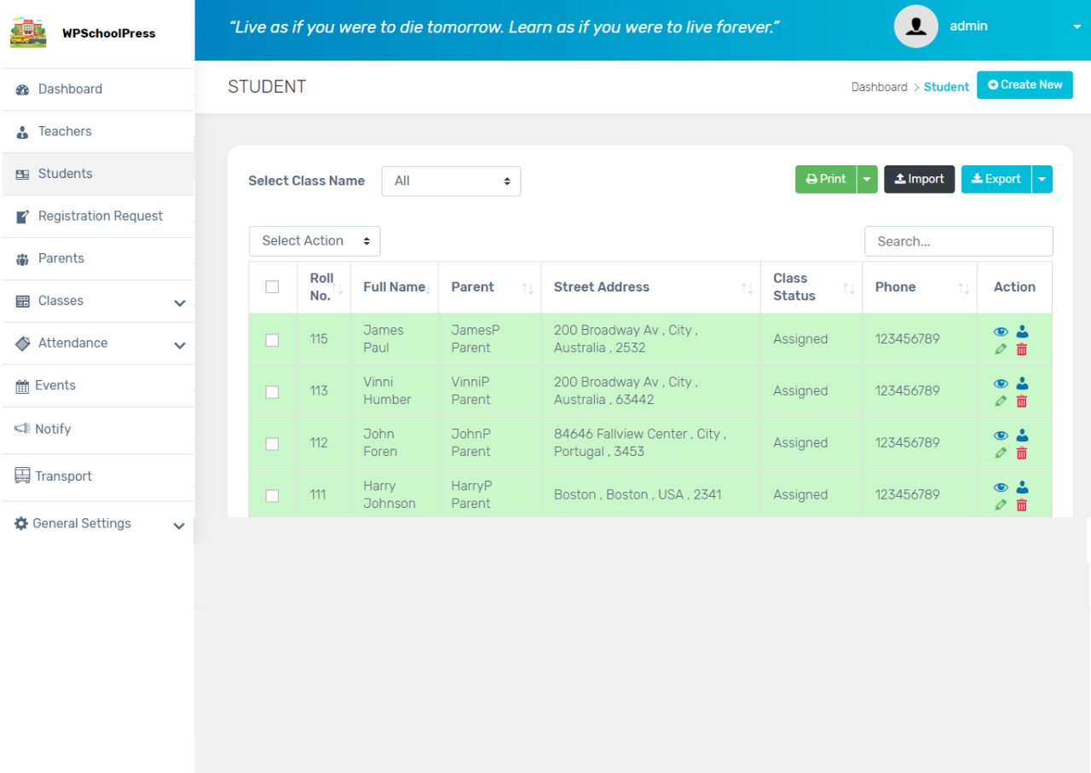
Student Table display
When the student inputs the login details to the form,
The api will carry the info to the backend and get the, required/necessary details of particular student.

Slide 23
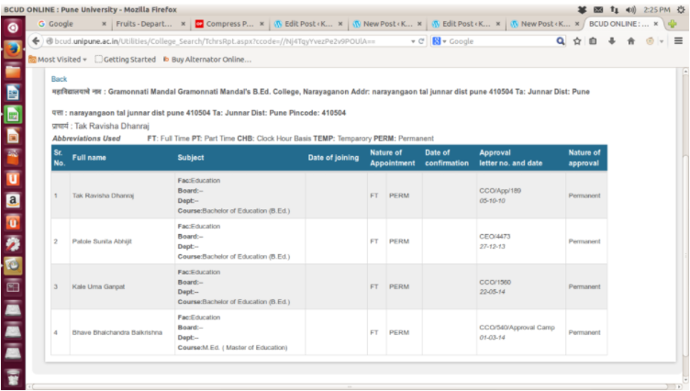
Faculty Table Display
When a faculty inputs his login details to the form,
From the backend database he’ll be able to get the required info like Id, Name, subject.,

Slide 24
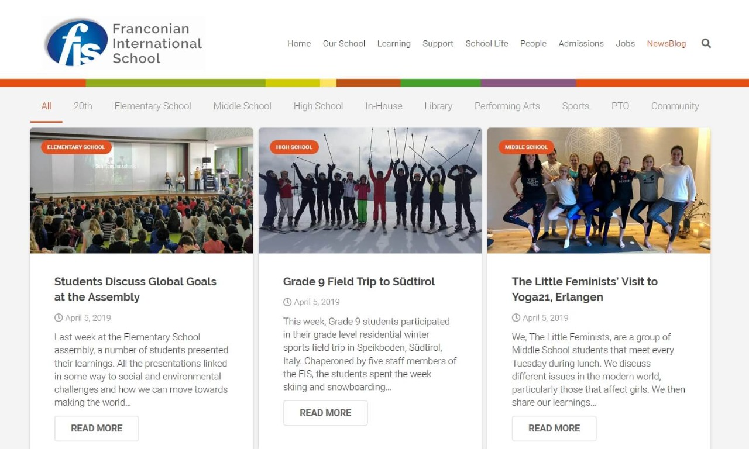
Event page display
The event page will have the latest activities that happened like,
School anniversary, sports events, food fest etc.,

Slide 25
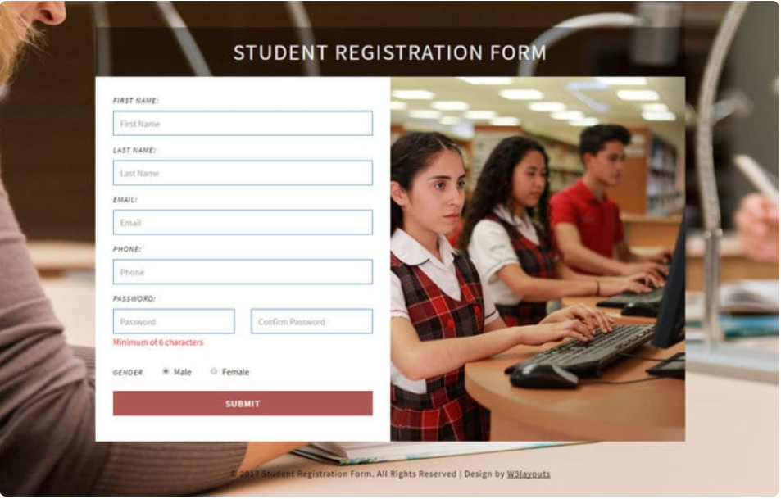
Student Form
The student login form with the input text and number types will collect the student data from each student and store it in the DB.

Slide 26
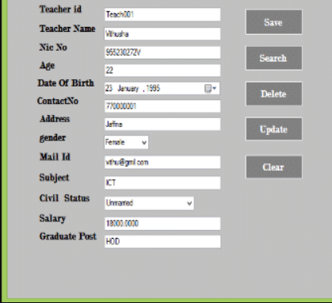
Faculty Form
The faculty form to collect data of a particular faculty and add it in the DB.
Takes in basic input of the faculty.

Slide 27
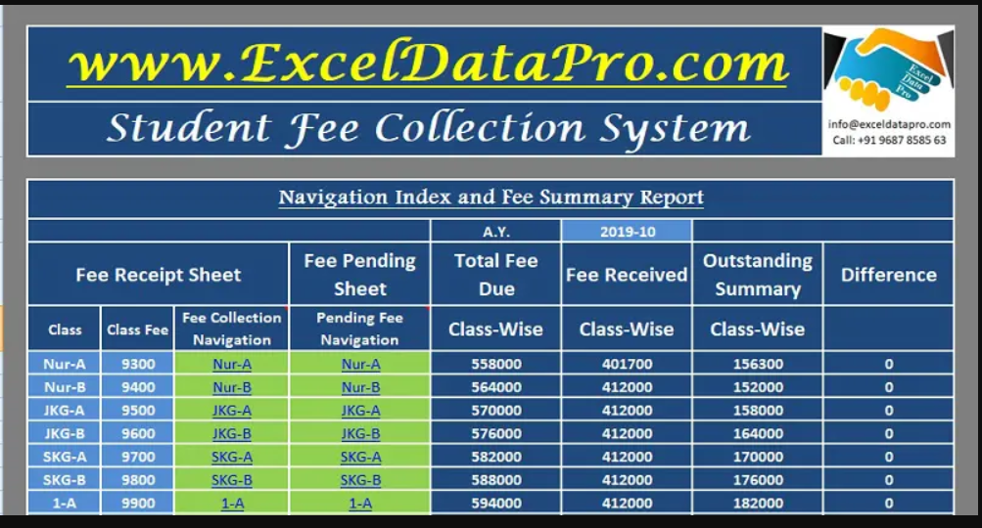
Fee Table
Displays the amount of fee that each student corresponding to the particular academic year has to pay

Slide 28
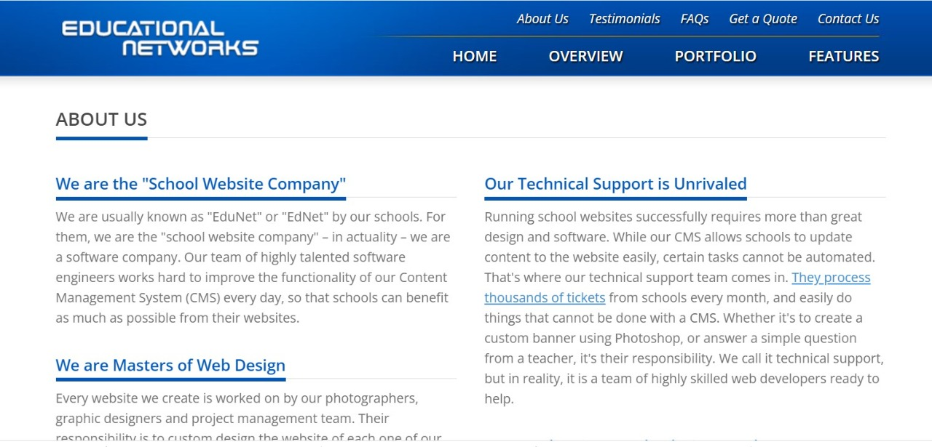
About Us page
Displays basic information about the school and different types of achievements, honors which they’ve received through years.

